Slide 1
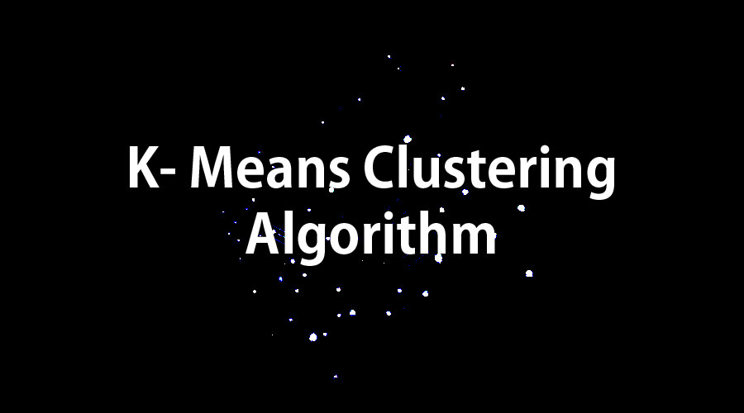

Slide 2
What is clustering?
Clustering is the process of dividing the datasets into groups,consisting of similar data points.
Points in the same group are as similar as possible.
Points in the different group are as dissimilar as possible.

Slide 3



Slide 4
What is K-Means clustering?
K-Means is a clustering algorithm whose main goal is to group similar elements or data points into a cluster.
‘K’ in K-Means represents the number of clusters.

Slide 5

Types of Clustering

Slide 6
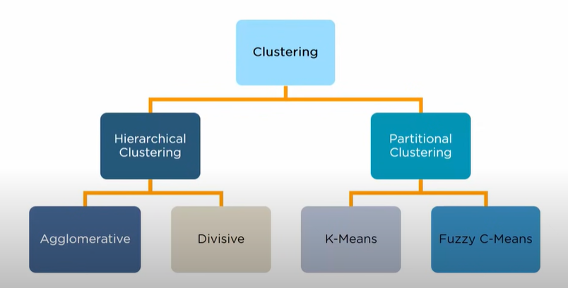

Slide 7
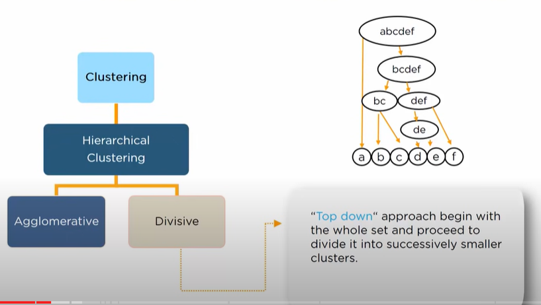
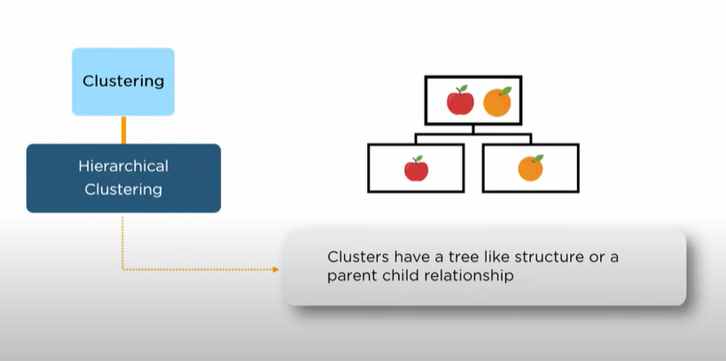
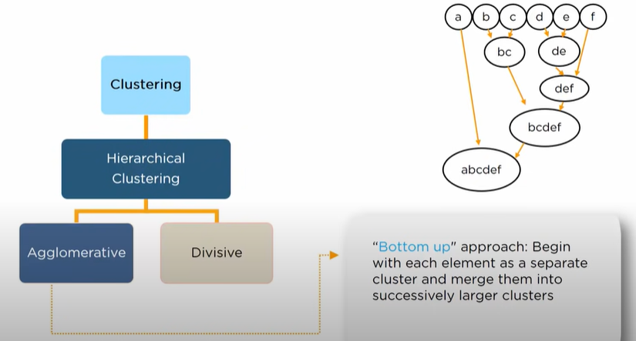

Slide 8
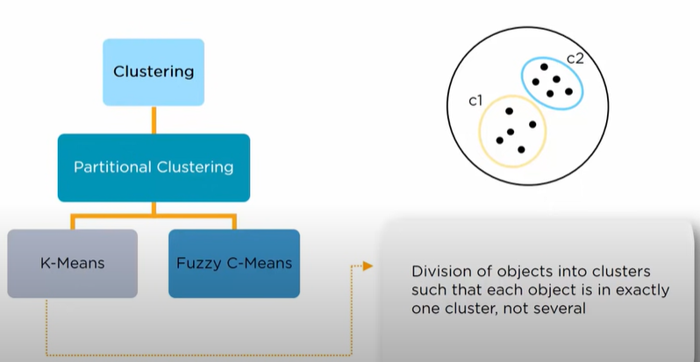
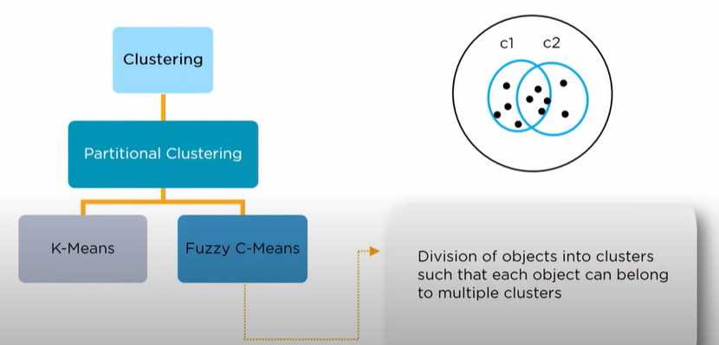

Slide 9
Applications of K-Means Clustering

Slide 10


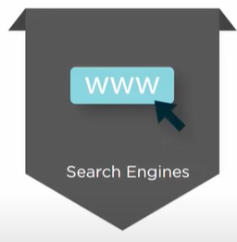


Slide 11
More Use Cases of K-Means Clustering
Retail Store
Insurance Company
Banking
Flickr
Amazon
Social Networking sites

Slide 12

How K-Means Clustering Algorithm works?

Slide 13
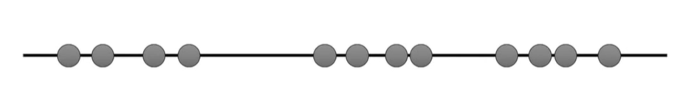
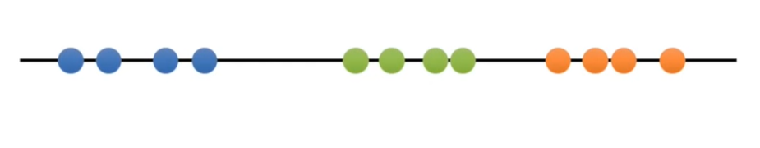
Step 1: Select the number of clusters you want to identify in your data.This is “k” in K-Means Clustering.

Slide 14
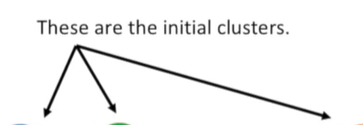
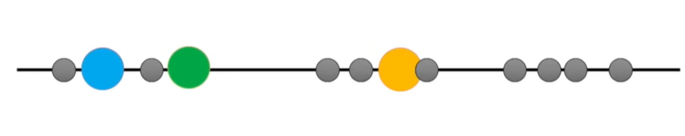
Step 2:Randomly select three distinct points

Slide 15
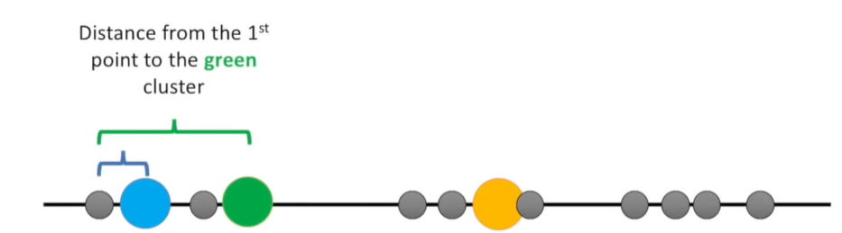
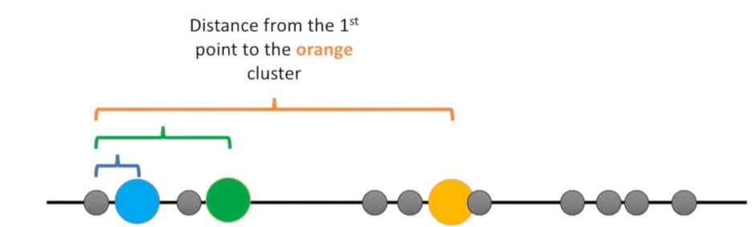
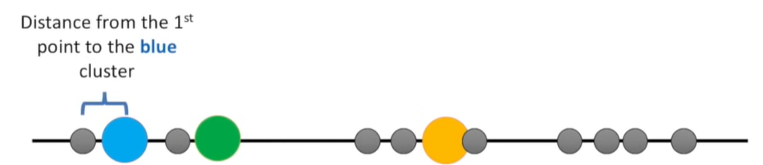
Step 3: Measure the distance between the first point and the three initial clusters.

Slide 16
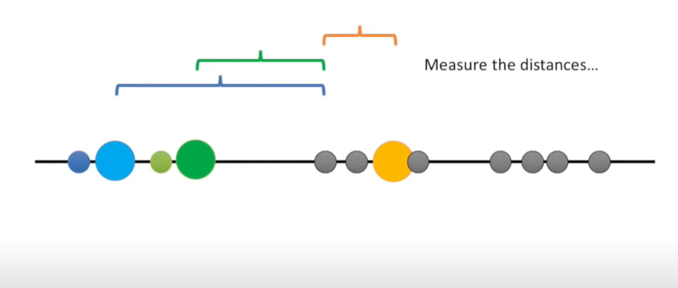
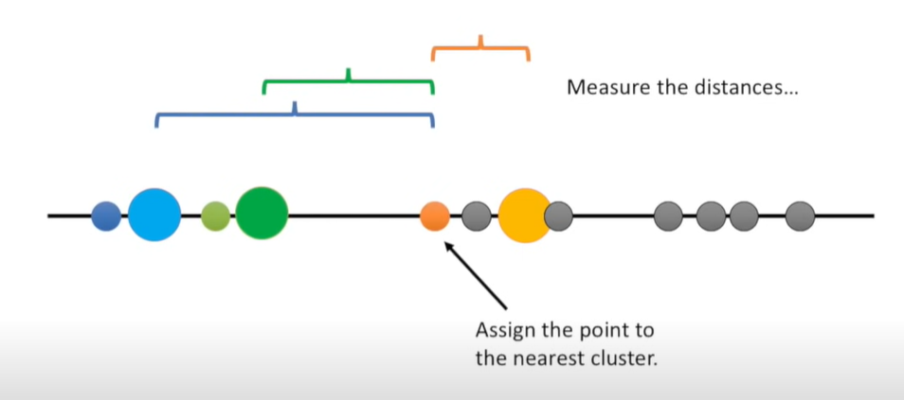
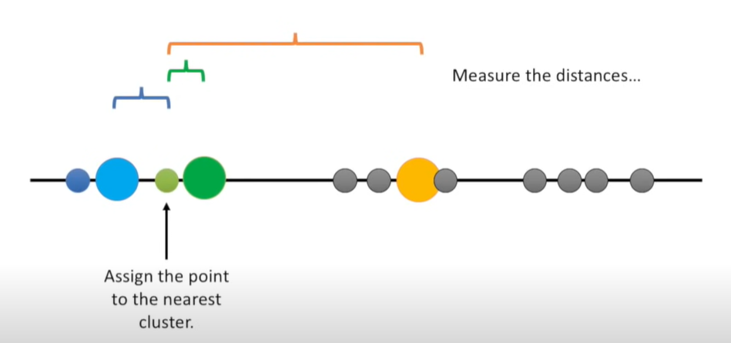
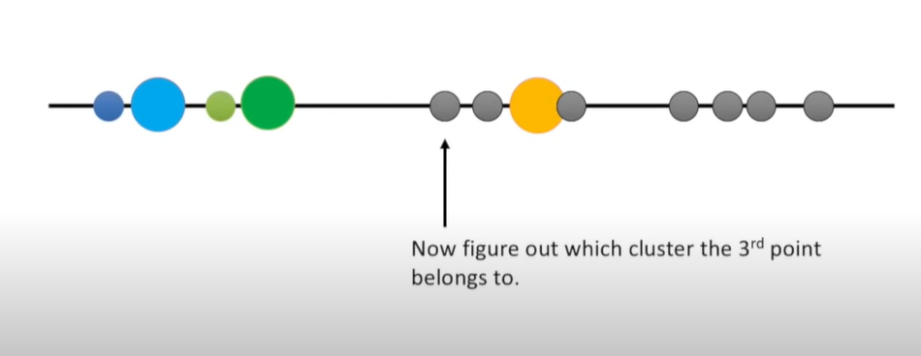
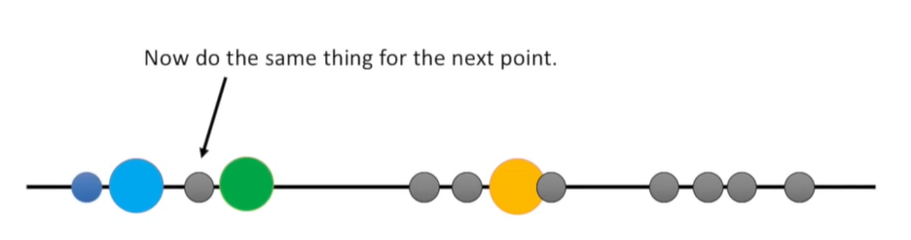
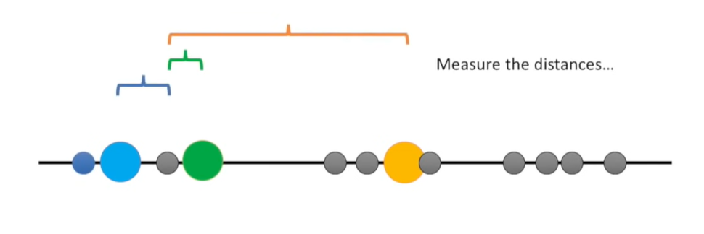
Step 4: Assign the first point to the nearest cluster.In this case the nearest cluster is the blue cluster.

Slide 17
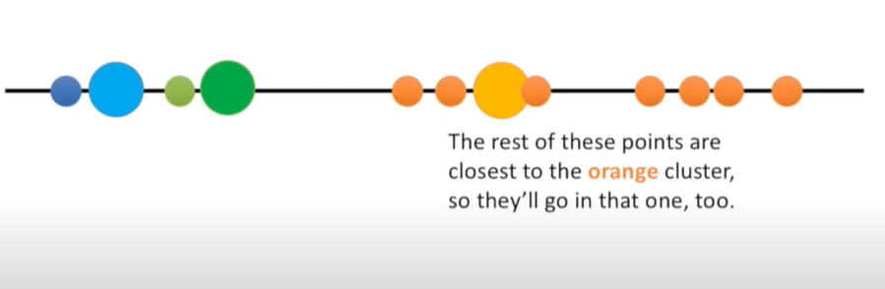

Slide 18
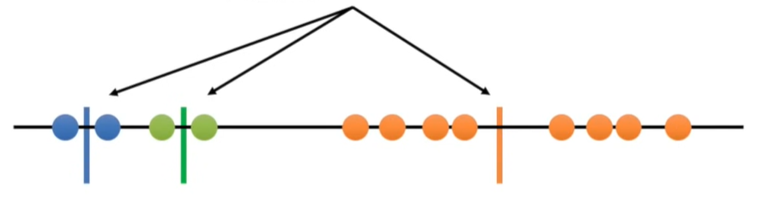
Step 5: Calculate the mean of each cluster.

Slide 19
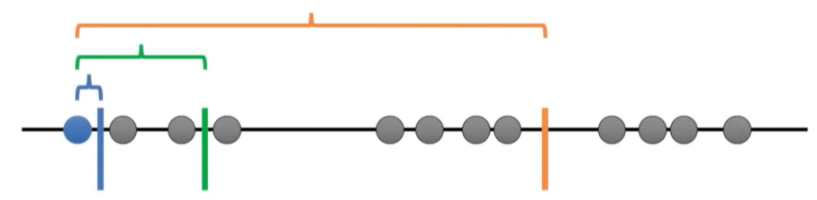
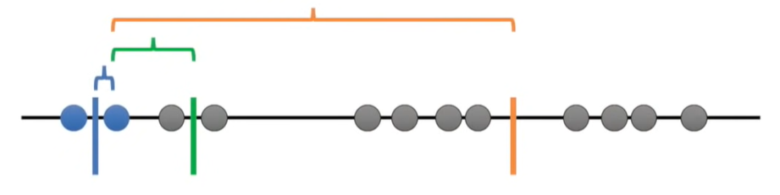

Slide 20
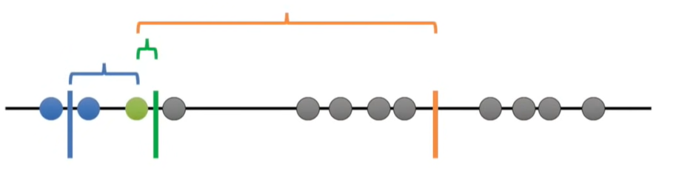
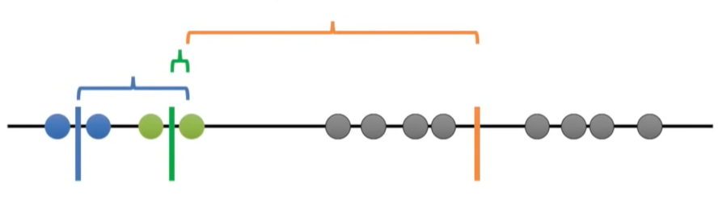

Slide 21
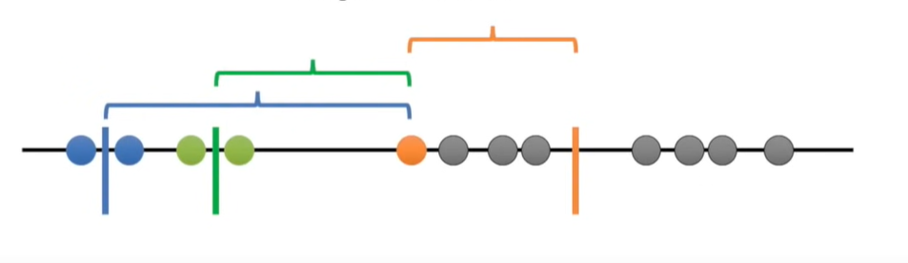
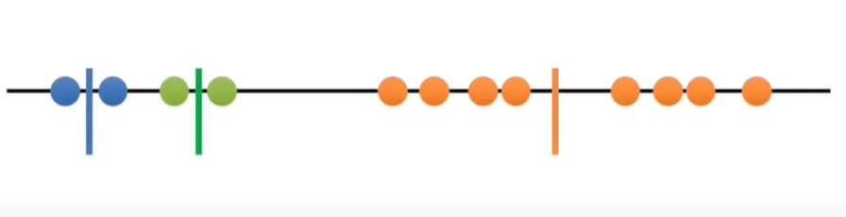

Slide 22

What we thought the clusters will be formed….
How the clusters were actually formed by the computer….

Slide 23
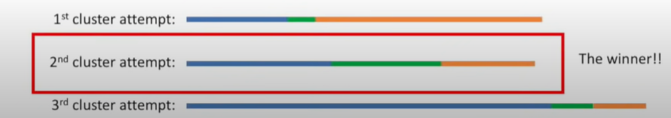

Slide 24
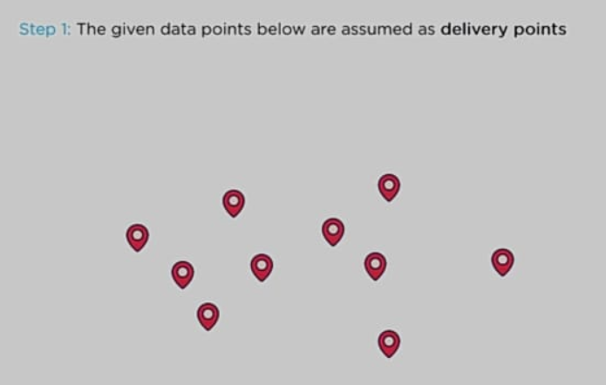

Slide 25
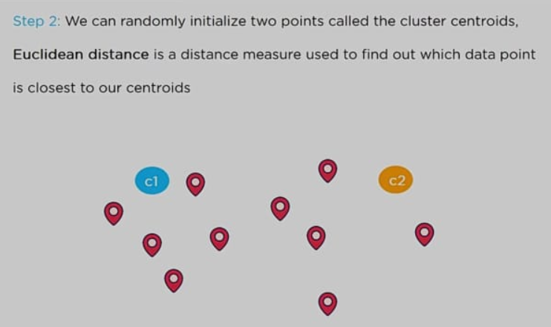

Slide 26
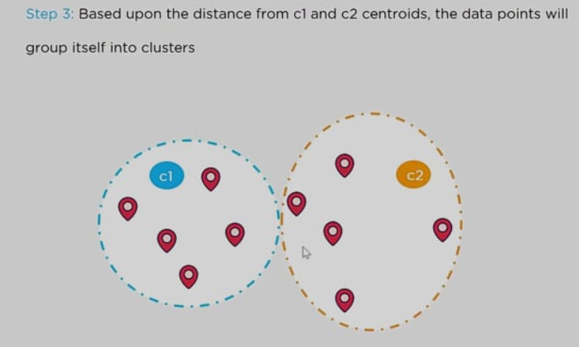

Slide 27
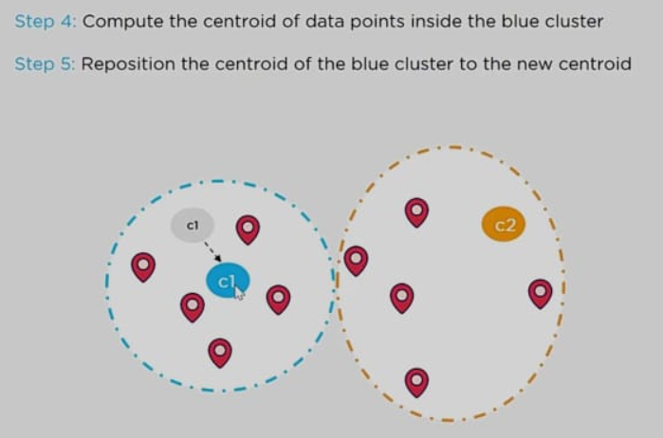

Slide 28
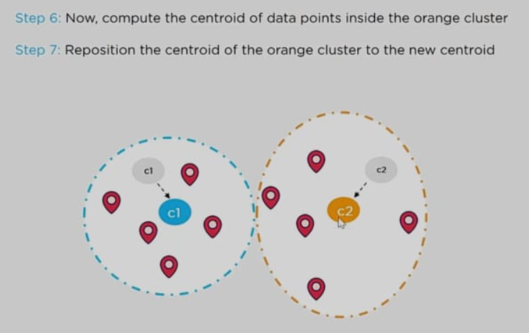

Slide 29
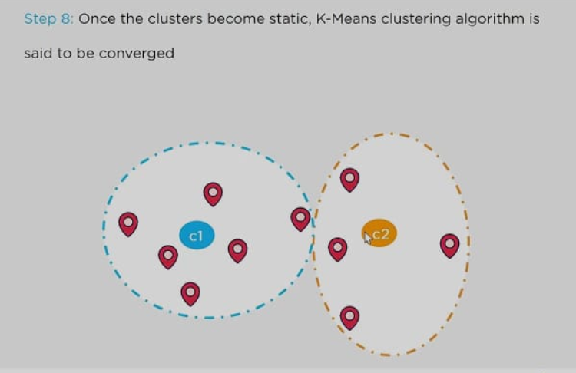

Slide 30
Distance Measure

Slide 31
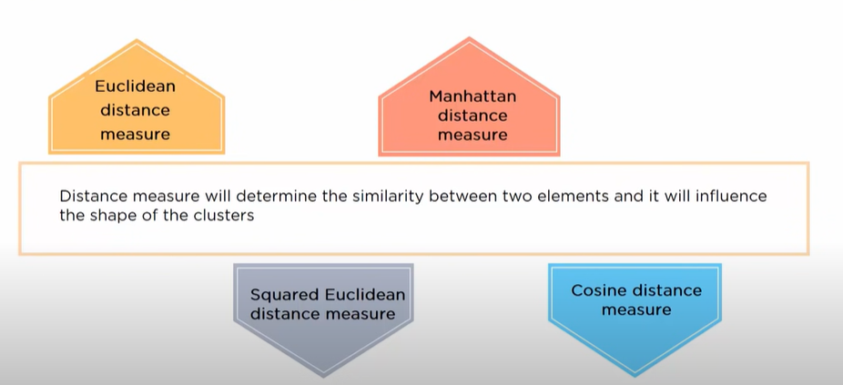

Slide 32
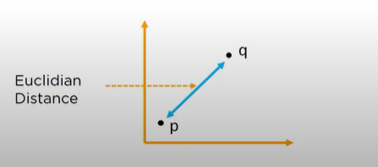
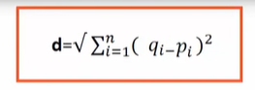
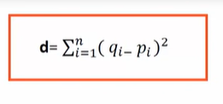
Euclidean Distance

Slide 33
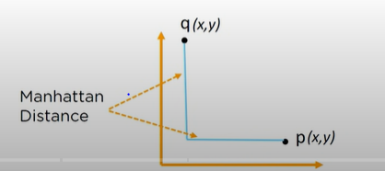
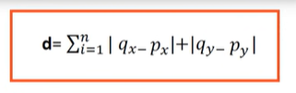
Manhattan Distance

Slide 34
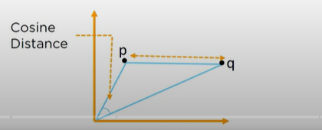
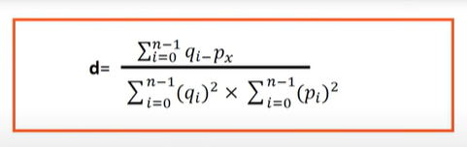
Cosine Distance

Slide 35
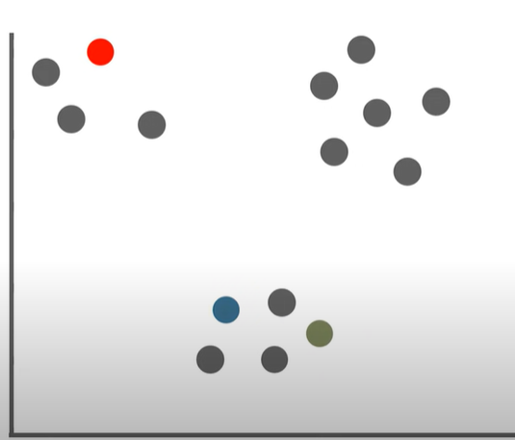
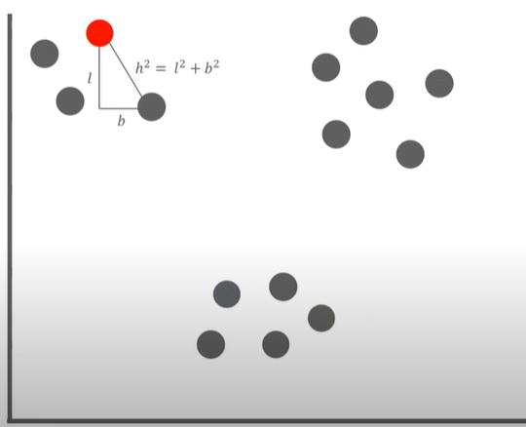

Slide 36
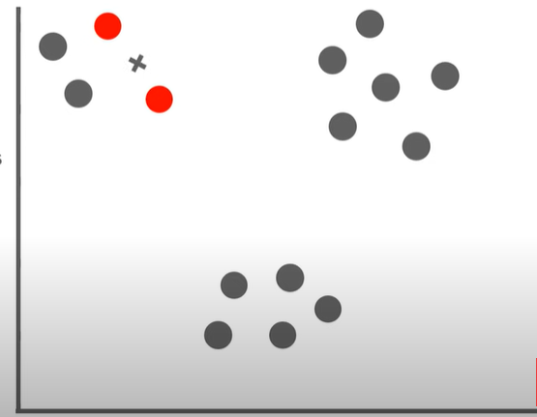
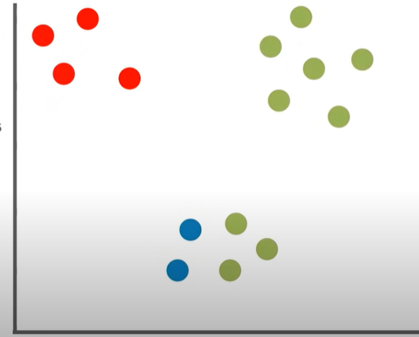

Slide 37
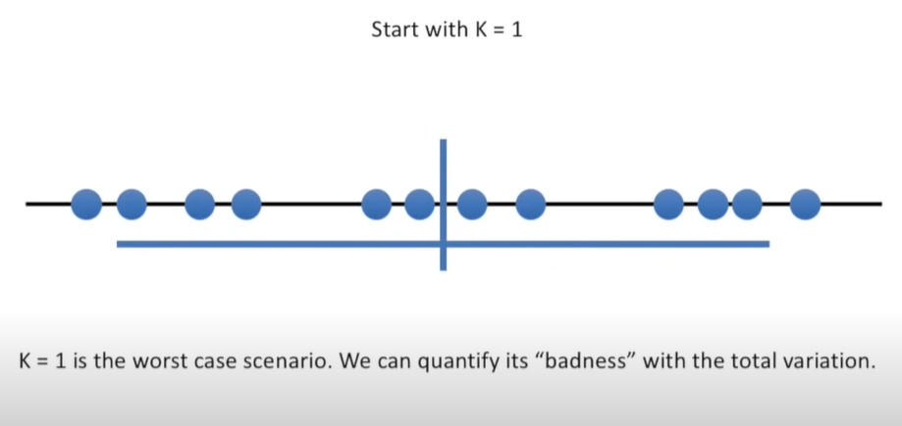
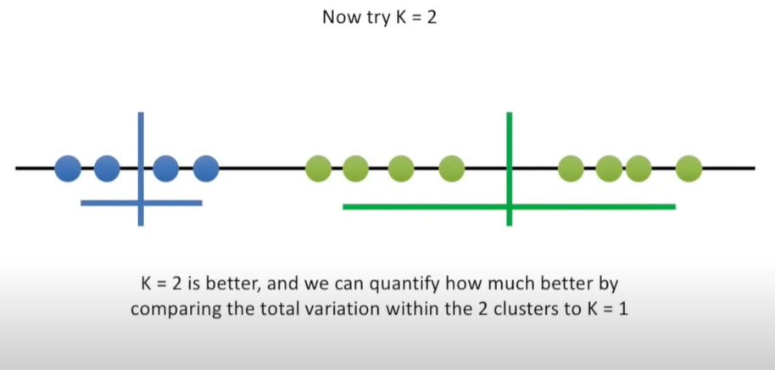
How to figure out what value to use for k?
One method can be to try with different values of k

Slide 38


Slide 39


Slide 40
Elbow Plot

Slide 41


Slide 42


Slide 43
Thank You

Slide 44
Clustering is very powerful due to the lack of labels. Getting labeled data is often expensive and time consuming. Clustering is often used for finding patterns in data. The found patterns are then often used in order to improve a certain product. One famous example is customer clustering. In customer clustering, groups of similar users can be found. If customers of one group buy certain products, the other customers of this group might also like them. Thus, targeted advertising can be applied to increase sales.
The optimal number of clusters is found using the computed Inertia values and the elbow method applied on the Inertia curve.

Slide 45

Inertia
The Inertia or within cluster of sum of squares value gives an indication of how coherent the different clusters are. Equation 1 shows the formula for computing the Inertia value.
N is the number of samples within the data set, C is the center of a cluster. So the Inertia simply computes the squared distance of each sample in a cluster to its cluster center and sums them up. This process is done for each cluster and all samples within that data set. The smaller the Inertia value, the more coherent are the different clusters.

